Slide 1
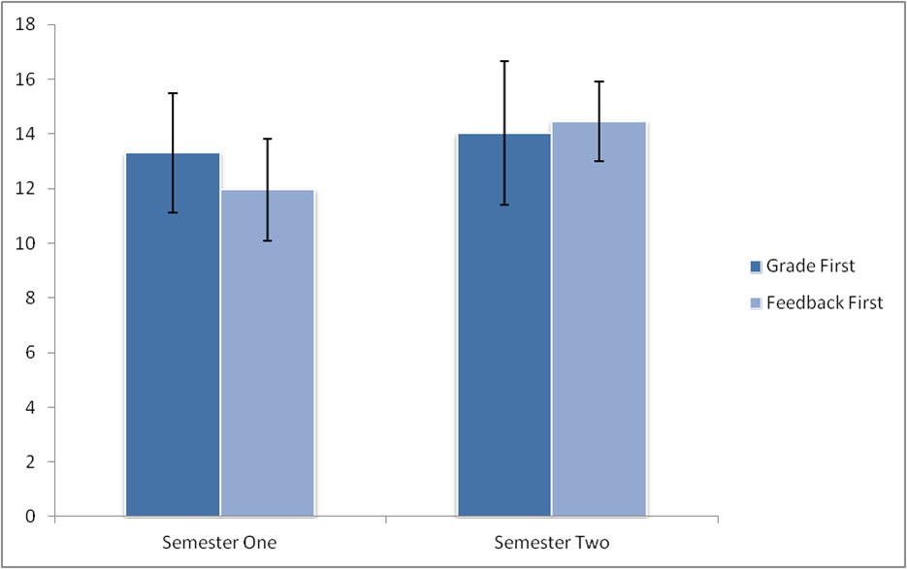
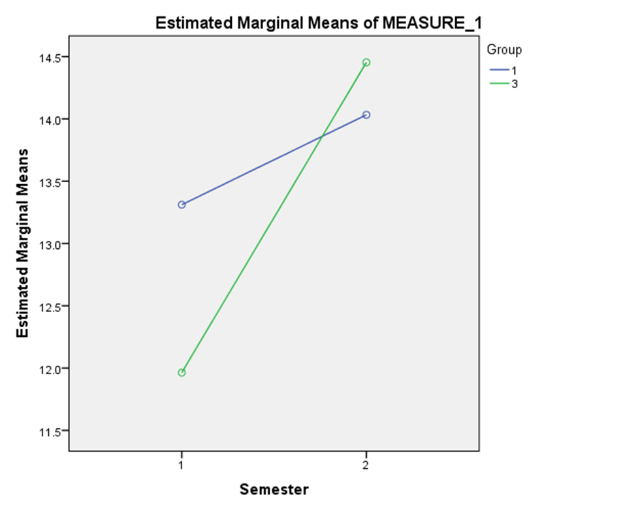
Feedback or Grades as an Initial Response to Assessed Work: A Snapshot Service Evaluation.
Gardner, P. L., Macleod, J., Miles, P. J. & Ramsey, A. F.
Introduction
Methods
A paired samples t-test showed that there was an overall difference in student performance in semester two compared to semester one (t(115) = -7.01, p=<.001).
A repeated measures ANOVA showed that there was no effect of group overall however there was an effect of semester (F (1, 114) = 59.69, p= <.001). This suggests that overall student performance improved in semester two compared to semester one.
It was also found that there was an interaction between semester and group (F(1, 114) = 18.11, p= <.001). This suggests that response condition had an effect on the level of performance improvement between assessments.
As shown in figure two there was a greater improvement in performance for students in the feedback group than the grade group.
Discussion
Feedback is a vital stage of the assessment process in higher education, giving students an opportunity to close the gap between their academic goals and their actual performance (Evans, 2012; 2013).
Unfortunately many students do not access or utilise feedback from assessment and instead may use only their grade as an indicator of performance (Bloxham & Campbell 2010; Draper, 2009).
The present study aims to investigate if students can be encouraged to access feedback and use it to improve their future performance in assessment by presenting feedback in the absence of grades.
The grades of students will be compared across the academic year to determine if giving feedback as an initial response compared to grade as an initial response had an effect on performance.
We expect to see the feedback first group to show a greater improvement in performance compared to the grade first group
In the absence of grade students are expected to be more likely to access feedback in order to gage their assessment performance.
106 second year psychology undergraduates at the University of St Andrews participated in the study. Students were ordered by matriculation number and then split into conditions.
Two conditions with different methods of presenting assessment results were compared, grade before feedback and feedback before grade.
Grades from a lab report assessment in semester one were compared with a similar task in semester two to determine if performance changed between semesters in each condition.
The current investigation has shown that presenting feedback prior grade may improve performance in future assessments by encouraging students to access their assessment feedback.
This may be due to students wishing to self assess their performance by looking at feedback when they have not been given their grade.
It could also be the case that that because feedback group had a lower mean grade in first semester than the grade group, individuals may have been motivated to work harder to improve their grades.
Encouraging the use of feedback could be beneficial to performance and there is little reason why feedback can not be presented to students before their grades.
Encouraging students to make use of feedback in the early stages of assessment could be particularly beneficial as students may not be able to access feedback at a later date even if they intended to (feedback may be removed from Moodle at the end of the academic year).
Results
The mean scores for the grade and feedback groups in semester one were 13.3 (SD= 2.18) and 11.96 (SD= 1.87) respectively (see fig. 1).
The mean scores in semester two were 14.03 (SD= 2.66) for the grade group and 14.46 (SD= 1.53) for the feedback group (see fig. 1).
The mean change in grade for the grade group was 0.72 and for the feedback group was 2.49.
Grade First
Feedback First
Figure 2. Plot showing the interaction effects for group and semester on student performance
Figure 1. Bar chart showing the mean grades in semester one and two for the grade and feedback conditions. Error bars show standard deviation.
References : Bloxham, S. & Campbell, L. (2010). Generating dialogue in assessment feedback: exploring the use of interactive cover sheets. Assessment & Evaluation In Higher Education, 35(3), 291-300.
Draper, S. (2009). What are learners actually regulating when given feedback?. British Journal Of Educational Technology, 40(2), 306-315.
Evans, C. (2012). Assessment Feedback: We can do better. Reflecting Education, 8(1), 1-9.
Evans, C. (2013). Making Sense of Assessment Feedback in Higher Education. Review Of Educational Research, 83(1), 70-120.

